Slide 1
Disaster Risk Reduction Working Group
30 March 2023, Gandhinagar, Gujarat

Slide 2
  Global context
  G20 context
  Priorities of DRRWG and Road Map
    Early Warning Systems
    Disaster and Climate Resilient Infrastructure
    Financing DRR
    Disaster Response & Recovery (BBB)
    Ecosystem based approaches
  DRRWG’s linkages with other Working Groups
AGENDA FOR DISCUSSION

Slide 3
Global Context
Development of deliverables
  4 loss reduction targets
  3 capacity development targets
  slow progress on 6 of the 7 targets
1
Sendai Framework for Disaster Risk Reduction
Development of deliverables
  At least 11 of the 17 Sustainable Development Goals can not be achieved without disaster risk reduction
  SDG 9 (Industry, Innovation and Infrastructure) and SDG11 (Sustainable Cities) directly linked
2
Sustainable Development Goals
  Enhanced Disaster Risk Reduction efforts are essential for Climate Change Adaptation
Development of deliverables
3
Climate Change Adaptation
Development of deliverables
4
Geophysical Hazards
  Global Disaster Risk from geophysical hazards is very high

Slide 4
G20 Context: Disaster Risk Reduction
Expected Average Annual Loss from disasters: $218 billion
~ 9% of annual G20 investment in infra
Success in saving lives but not livelihoods
High risk of hydro-met and geo-physical disasters
  High disaster mortality risk as well as economic loss risk
Technical capacity to serve the world e.g. in Early Warning Systems
Opportunity to work across sectors through other Working Groups
Build on past discussions on Disaster Risk Reduction in G20

Slide 5
Priorities of DRRWG
Global coverage of Early Warning Systems for all hydro-meteorological disasters
Increased commitment to disaster and climate resilient infrastructure systems
Stronger national financial frameworks for increased public and private sector investment in DRR; and robust disaster risk finance mechanisms
Strengthened national and global disaster response and recovery systems including “build back better”
Increased application of ecosystems-based approaches to disaster risk reduction

Slide 6
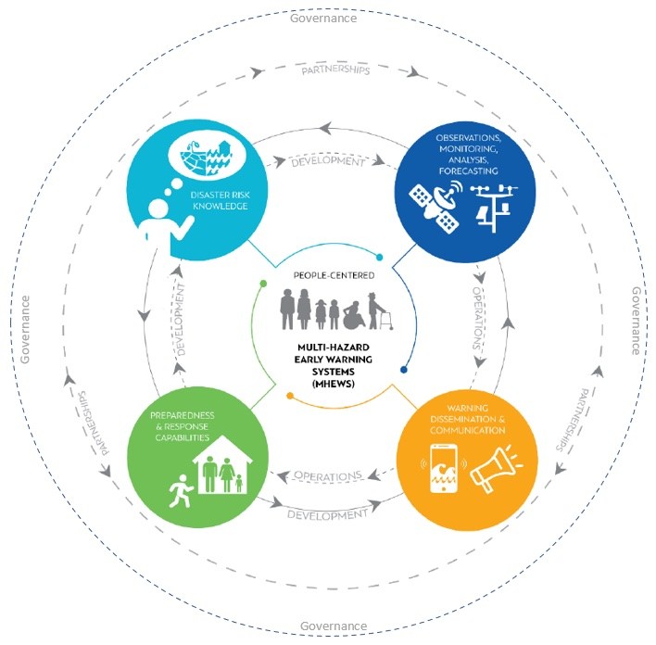
1. Early Warning Systems
Disaster risk knowledge, based on systematic collection of data and disaster risk assessments (20%)
Detection, monitoring, analysis and forecasting of hazards and possible consequences (31%)
Dissemination and communication, of authoritative, timely, accurate and actionable warnings, and associated information on likelihood and impact (42%)
Preparedness at all levels to respond to the warnings received (27%)

Slide 7
1. Early Warning Systems
Financing Early Action:
  Compendium of fit-for-purpose and fit-for-budget early warning business models that are more anticipatory, accessible to a broader range of EWEA stakeholders
    (by June 2023)
Regional and sub-regional plans of action
  Complement the UNESCAP Study with regional analysis of other regions
    (by June 2023)
Digital platform for knowledge sharing
  Structure around the four sub-systems
  Particular emphasis on gap areas (Risk Knowledge and Preparedness/ Early Action)

Slide 8
2. Disaster and Climate Resilient Infrastructure
Infrastructure as a driver of sustainable development, economic growth (and recovery); opportunity to transform the future
Target D is the least reported target under SFDRR
Systems vs Sectoral approach to Infrastructure
Uncertain risk scenarios over the life cycle of the infrastructure systems
Transitioning infrastructure Systems
  Standards and Codes still being developed
  Regulatory environment is evolving
  Regulation/ certification of professions

Slide 9
2. Disaster and Climate Resilient Infrastructure
Inventory of infrastructure risk assessment tools and data platforms
  Training and capacity building of potential users
  Adapting existing tools to local, national and sectoral context
  Use case examples of decision making at the national and sub-national levels
    (July 2023 with a preview by May 2023 )
Compendium of good practices on disaster resilient infrastructure
  Resilient transitioning infrastructure systems
    (July 2023)
Framing a study of different models of regulatory frameworks for resilient infrastructure systems
    (July 2023)

Slide 10
3. Financing frameworks for DRR: increasing public & private investments
Mainstreaming vs. Ring-fencing DRR Financing
Legal and Formal Framework for DRR Financing
Diversified financial frameworks
Address the entire spectrum of Disaster Risk Management needs
Accountability and Transparency: measuring outcomes
Pursue it as a shared responsibility
  All the levels of government– national, sub-national, and local
  NGOs, Private Sector, and Civil Society
  Insurance, Banks, and Microfinance Sector
  Philanthropy, Crowd funding, and Remittances

Slide 11
3. Financing Frameworks for DRR
Side event in the margins of the next DRRWG meeting to explore disaster risk financing
    Second half of May 2023
A compendium of good practices on financing of disaster risk reduction efforts (public and private sector)
    By July 2023
Compendium of good practices on legal and regulatory arrangements for financing disaster risk reduction
    By September 2023

Slide 12
4. Disaster response & recovery systems “build back better”
Linkages between: “Early Warning, Early Action” and “Financing”
Institutional mechanisms and capacities for assessing damages and losses and planning for recovery
Predictable financing mechanisms for funding “build back better”
  Earmarked resources in national budgets
  CERF like mechanism for recovery?
  Risk transfer mechanisms/ Risk Pooling/

Slide 13
4. Disaster response & recovery systems “build back better”
Good practices on financing “build back better” case examples of past events
    July 2023
Input paper on possible international and national financing mechanism(s) for supporting post-disaster recovery
    July 2023

Slide 14
5. Ecosystem based approaches
Quantifying disaster risk reduction benefits of ecosystems
Good practices on combining grey and green infrastructure
Ecosystem-based approaches as an adaptive risk management strategy
Analytical overview of linkages between regulations governing disaster risk management and ecosystems

Slide 15
Linkages with other Working Groups
Environment and Climate Sustainability Working Group
Energy Transition Working Group
Infrastructure Working Group
Development Working Group
Sustainable Finance Working Group

Slide 16





Example: DRRWG’s and ECSWG
DRRWG
Global coverage of Early Warning Systems
Making infrastructure systems disaster and climate resilient
Stronger national financial frameworks for DRR
Strengthened national and global disaster response systems
Increased application of ecosystems-based approaches to DRR
ECSWG
Biodiversity, Land Degradation and Ecosystem Restoration
Sustainable and resilient Blue Economy
Resources Efficiency and Circular Economy.

Slide 17
Time Lines
1st Working Group Meeting: Gandhinagar, 30 March-1April 2023
  Side Event on Early Warning, Early Action
  Side Event on Resilient Infrastructure
2nd Working Group Meeting: Mumbai, May 2023
  Side Event on Disaster Risk Finance
  Side Event on Resilient Recovery (?)
  Side Event on Infrastructure Risk Assessment and metrics (?)
  Paper on Future Directions of the WG
3rd Working Group Meeting: Chennai, July 2023
  Completion of Key Knowledge Products; Joint Statement; Future Directions for the WG

Slide 18
Thank you

